Slide 1


Genetic Algorithm
Carried out by
Shubham Sinha (1RN17IS092)
Sannidhi Bhat (1RN16IS023)
Richa Saraf (1RN17IS077)
Tilak Raj (1RN17IS109)

Slide 2
CONTENTS
INTRODUCTION
ABSTRACT
SYSTEM REQUIREMENTS
SYSTEM ARCHITECTURE
IMPLEMENTATION
RESULT
CONCLUSION
REFERENCES

Slide 3
SYSTEM REQUIREMENTS
HARDWARE
SOFTFWARE
Processor : Pentium –IV
Speed : 2.33 GHz
RAM : 2 GB(min)
Hard Disk : 20 GB
OS : Windows 7
Language : C
IDE : CodeBlocks
Compiler : MinGw

Slide 4
ABSTRACT
A demonstration of Genetic Algorithm using a C-Program
Genetic Algorithm finds its application in a various fields like, Robotics, Engineering Design, Hardware Evolution, Optimization of Routes, Biomimetic Invention, Computer Gaming and many more.
Ours demonstration visualises the evolution of a randomly spawned generation of a hundred organisms having poor fitness & wide diversity converging to a generation having very high fitness & wide diversity. Its demonstrates how the better characteristics of the individuals are carried to next generations and the new generation are superior to their ancestors.

Slide 5
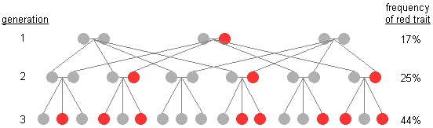
INTRODUCTION
The genetic algorithm is a method for solving both constrained and unconstrained optimization problems that is based on natural selection, the process that drives biological evolution. The genetic algorithm repeatedly modifies a population of individual solutions. At each step, the genetic algorithm selects individuals at random from the current population to be parents and uses them to produce the children for the next generation. Over successive generations, the population "evolves" toward an optimal solution.

Slide 6
The following outline summarizes how the genetic algorithm works:
1. The algorithm begins by creating a random initial population.
2. The algorithm then creates a sequence of new populations. At each step, the algorithm uses the individuals in the current generation to create the next population. To create the new population, the algorithm performs the following steps:
a. Scores each member of the current population by computing its fitness value. These values are called the raw fitness scores.
b. Selects members, called parents, based on their fitness scores.
3. Some of the individuals in the current population that have higher fitness are chosen as elite. These elite individuals are passed to the next population.
4. Children are produced by combining the vector entries of a pair of parents, the process is called crossover.
5. The current population is replaced with the children to form the next generation.
6. The algorithm stops when one of the stopping criteria is met.

Slide 7
Initial Population:
The initial generation is populated using a random function to ensure that the population has good diversity.
Creating Next Generation:
  Elite children are the individuals in the current generation with the best fitness values. These individuals automatically survive to the next generation.
  The algorithm creates crossover children by combining pairs of parents in the current population. The crossover function creates the child as a random weighted average of the parents.
Stopping Conditions
  The algorithm stops when the value of the fitness function for the best point in the current population is greater than or equal to Fitness limit.

Slide 8
SYSTEM ARCHITECTURE
Initial Generation is Populated
Organism is initialized
Genes are assigned
Fitness is calculated
Evolution of New Generation
Two parents are randomly selected from current Gen
Parents are crossed to create child organism
Checks if Stop-Condition is True
Stops if fitness of org is equal to optimum fitness

Slide 9
IMPLEMENTATION
ORG init_organism(void)
{
ORG temp;
int i,test;
for(i=0;i<GENE_NO;i++)
{
test=rand()%GENE_TYPES;
switch(test)
{
case 0:temp.gene[i]='A';break;
case 1:temp.gene[i]='B';break;
case 2:temp.gene[i]='C';break;
case 3:temp.gene[i]='D';break;
}
}
The init_organism() function initializes the organism and assigns the genes using rand() function. The random integer produced is by the rand() function is then divided by GENE_NO, the gene is assigned according to remainder.

Slide 10
2. void populate_gen(ORG gen[])
{
int i;
for(i=0;i<GEN_SIZE;i++)
{
gen[i]=init_organism();
}
}
The populate_gen() function populates an array of hundred organism consisting the initial generation.

Slide 11
3. void assign_fitness(ORG gen[],ORG ideal)
{
int i;
for(i=0;i<GEN_SIZE;i++)
{
gen[i].fitness=fitness_calculator(gen[i],ideal);
}
}
The assign_fitness() function assigns the fitness to each organism using fitness_calculator().

Slide 12
4. float avg_gen_fitness(ORG gen[])
{
int i;
float sum=0;
for(i=0;i<GEN_SIZE;i++)
{
sum=sum+gen[i].fitness;
}
return(sum/GEN_SIZE);
}
The avg_gen_fitness() function calculates the average fitness of the generation by summing the fitness scores of all the organisms in the generation and then dividing it by GEN_SIZE.

Slide 13
5. ORG* evolve_gen(ORG gen[])
{
int i;
static ORG next_gen[GEN_SIZE];
for(i=0;i<GEN_SIZE;i++)
{
next_gen[i]=crossover(select_one(gen),select_one(gen));
}
return next_gen;
}
The evolve_gen() function uses select_one() function to select two parents from the generation and the uses crossover() to cross the parents to produce a new organism.

Slide 14
6. ORG select_one(ORG gen[])
{
int sum=0,fitness_total,i,stop_point;
fitness_total = total_fitness_calculator(gen);
stop_point=rand()%(fitness_total+1);
for(i=0;i<GEN_SIZE;i++)
{
sum=sum+gen[i].fitness;
if(sum>=stop_point)
{
return(gen[i]);
}
}
}
The select_one() function uses a random stop_point whose range is from 0 to total fitness score of the generation. The selected organism is the organism with current index when the sum becomes greater than or equal to stop_point.

Slide 15
7. ORG crossover(ORG par1,ORG par2)
{
ORG child;
int cross_point,i;
cross_point=rand()%GENE_NO;
for(i=0;i<GENE_NO;i++)
{
if(i<=cross_point)
{
child.gene[i]=par1.gene[i];
ideal_reached = i;
}
else
{
child.gene[i]=par2.gene[i];
}
}
child.fitness=-1;
return child;
}
The crossover() function uses a random cross_point whose range is from 0 to GENE_NO. When the index is smaller than or equal to cross_point, genes to the child are assigned from parent 1 and for index greater than cross_point then genes are assigned form parent 2.

Slide 16
8. int check_stop_condition(ORG gen[])
{
int i;
for(i=0;i<GEN_SIZE;i++)
{
if(gen[i].fitness==GENE_NO)
{
return 1;
}
}
return 0;
}
The check_stop_condition checks if the fitness score of any organism is equal GENE_NO, if yes, then returns TRUE(1) or FALSE(0).

Slide 17
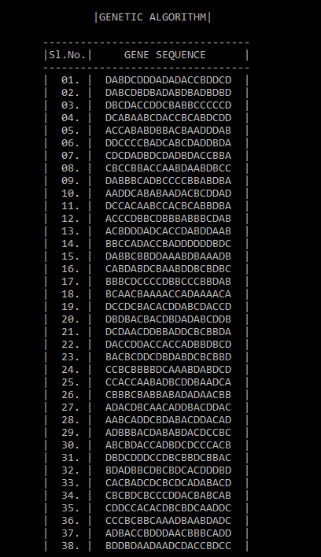
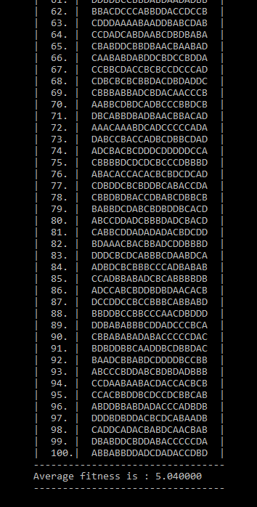
RESULTS

Slide 18
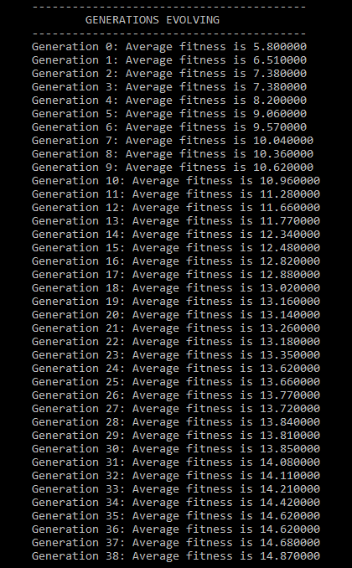
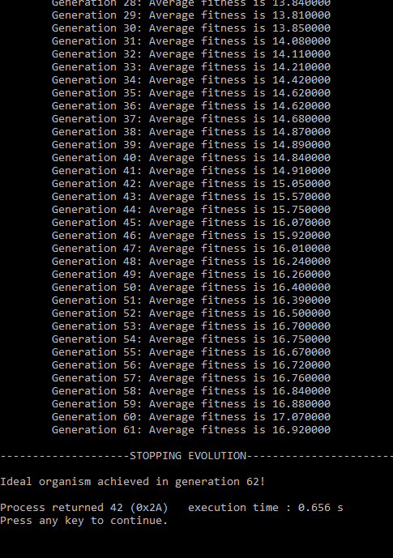

Slide 19
CONCLUSION AND FUTURE ENHANCEMENTS
Genetic Algorithms are original systems based on the supposed functioning of the living. The method is very different from classical optimization algorithms. These algorithms are nevertheless extremely efficient and are used in many fields.
It is easy to understand, modular, separate from application supports multi-objective optimization. It is very flexible in forming building blocks for hybrid applications.
The Genetic Algorithm program can be adapted suitably for more applications like Route Optimization, Product Evolution and many more.

Slide 20
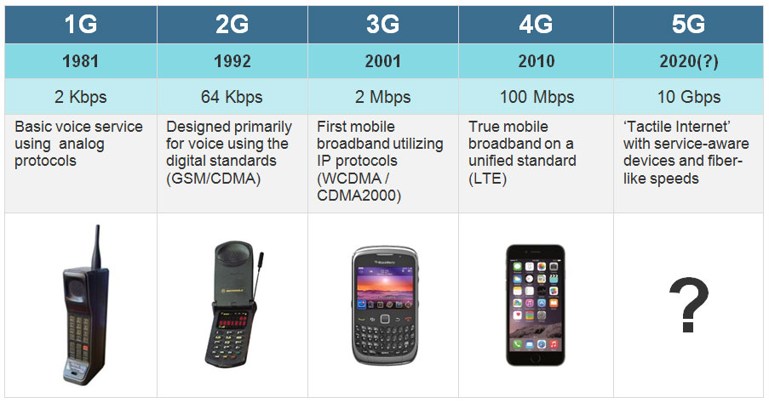
APPLICATIONS
1. 1G, 2G, 3G, 4G - The Evolution of Wireless Generations

Slide 21
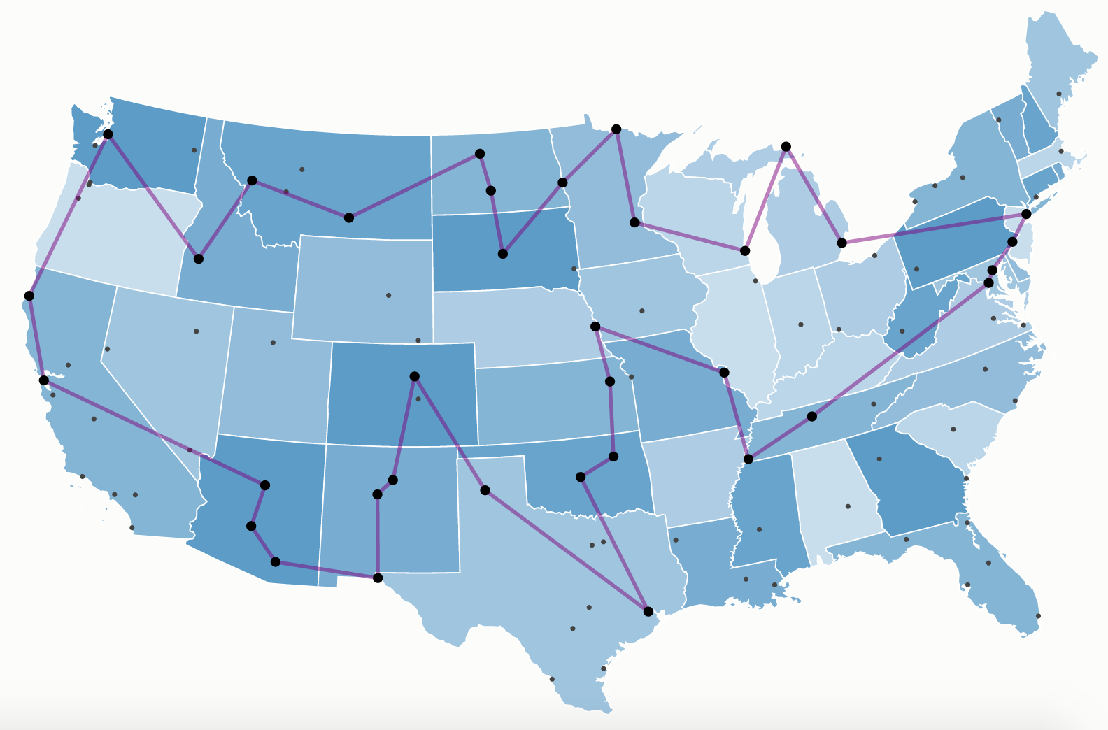
2. Travelling Salesman Problem
Given a set of cities and the distance between every pair of cities, then the problem is to find the shortest possible route that visits every city exactly once and return to the starting point.

Slide 22
REFERENCES
1. MathWorks :
https://in.mathworks.com/help/gads/what-is-the-genetic-algorithm.html
2. GeeksforGeeks :
https://www.geeksforgeeks.org/genetic-algorithms
3. Tutorials Point :
https://www.tutorialspoint.com/genetic_algorithms

Slide 23
THANK YOU

